Slide 1

Small Church Big Impact
“Small Church Big God”
NWC Rural Ministry Webinar
January 15, 2026

Slide 2

God’s Perspective
“Then he said to me, ‘This is the word of the Lord to Zerubbabel: Not by might, nor by power, but by My Spirit, says the Lord of hosts.’”
Zechariah 4:6
Theology Lesson #1
God does not dole out His Spirit in proportion to the size of the church

Slide 3
God’s Perspective
“Whoever has despised the day of
small things shall rejoice.”
Zechariah 4:10
Theology Lesson #2
God does not view a church that is smaller in size as inferior but a source of joy

Slide 4
God’s Perspective
“Whoever has despised the day of
small things shall rejoice.”
Zechariah 4:10
Day = a period of time, a season of time
Small things = smaller temple and its ministries
Small = size, insignificant
Despise = hold as insignificant or unimportant, belittle

Slide 5
God’s Perspective
“Whoever has despised the day of
small things shall rejoice.”
Zechariah 4:10
This verse “challenges one who would look down upon something small in which God is glorified.”
Merrill Unger

Slide 6
God’s Perspective
“Whoever has despised the day of
small things shall rejoice.”
Zechariah 4:10
We despise small things when…
…we diminish our community or church with our words
…we don’t prepare as much for a smaller number
…we jump to conclusions based upon size alone
…we assume that limited resources limits God
…we assume small size translates into small results

Slide 7
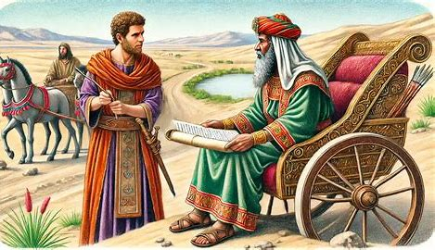
God’s Perspective
“Whoever has despised the day of
small things shall rejoice.”
Zechariah 4:10
Philip encountered the Ethiopian Eunuch at a remote outpost who then evangelized Ethiopia. Might one person in your church be used of God to reach an entire nation?

Slide 8
God’s Perspective
“Whoever has despised the day of
small things shall rejoice.”
Zechariah 4:10
“Never despise…small things, for God is glorified in small things and uses them to accomplish great things.”
Tom Constable

Slide 9
No Little Places
“In God’s sight there are no little people and no little places.”
Francis Schaeffer

